Slide 1

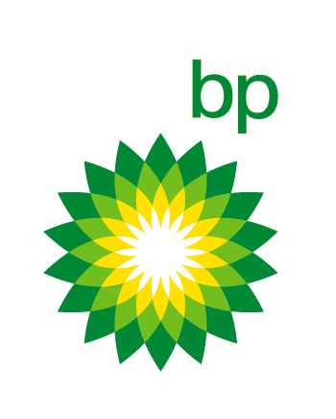



Business update
1st quarter 2022 results

Slide 2
Performance (end of 1Q 2022)
 | Production
 | ACG
 | oil (mb/d) | 434
 | oil (mmte) | 5
 | SD
 | gas (bcm) | 6
 | condensate (mmte) | 1
 | Opex ($ million)
 | ACG | 133
 | BTC | 9
 | SD | 759
 | SCP | 14
 | Capex ($ million)
 | ACG | 396
 | BTC | 4
 | SD | 88
 | SCP | 0.3

Slide 3
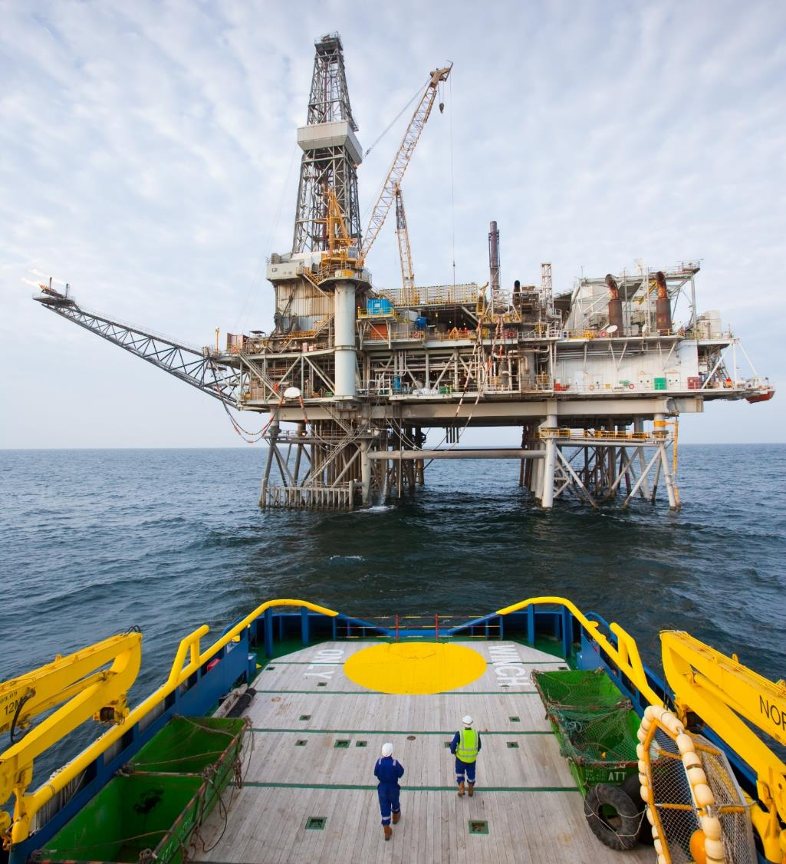
1Q 2022 highlights –ACG
ACG completed 3 oil producer wells during the quarter.
Total oil production from ACG since start has reached around 4.1 billion barrels.
Chirag platform

Slide 4
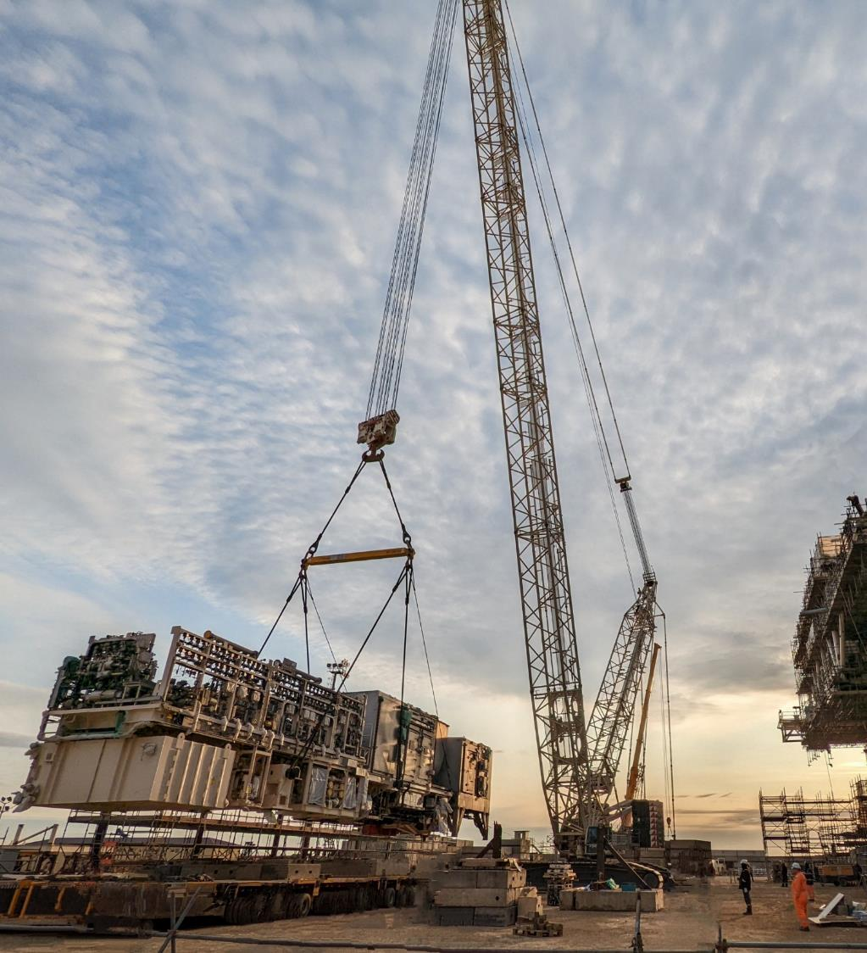
1Q 2022 highlights –ACE project
Construction activities are currently at peak with about 5,500 people involved and 70% overall project progress achieved.
Installation of the ACE subsea oil and gas lines completed.
Topsides and drilling facilities fabrication continued – several major liftings completed; dropped object structure and topsides under deck platform installed; drilling module and topsides commissioning progressed. In February, the topsides fabrication staff achieved
10 million work-hours without a safety incident.
Jacket fabrication continued - east tower frame lifted onto the jacket; post roll-up welding of frame 7 to the centre box completed; post roll-up welding of the tower frames onto the jacket continued.
Gas injection compressor lifting at Bibi-Heybat yard

Slide 5
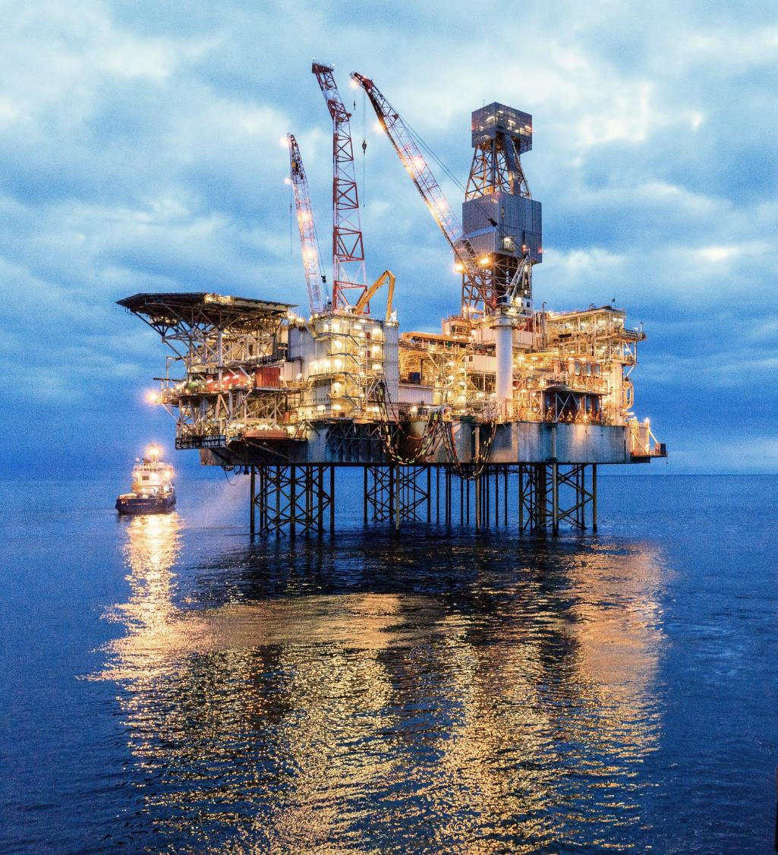
1Q 2022 highlights –Shah Deniz
Shah Deniz has produced about
164 billion cubic metres of gas and about 37 million tonnes of condensate since start.
Shah Deniz 2 progressed towards production start-up from the West South Flank - subsea installation activities mostly completed; diving activities for pipeline tie-ins progressed; topsides construction on the Shah Deniz Bravo platform nearing completion.
Shah Deniz Alpha platform

Slide 6
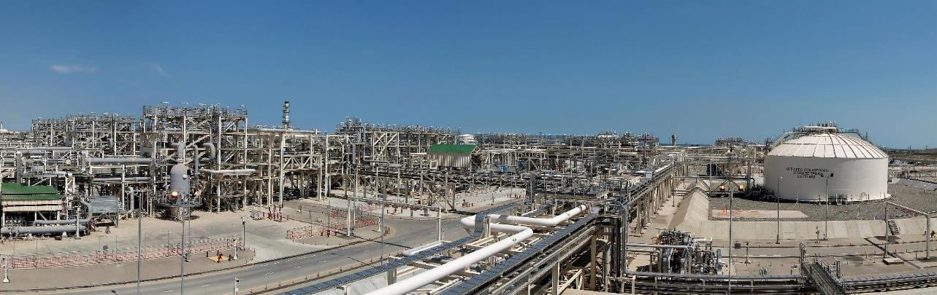
1Q 2022 highlights –Sangachal terminal
In 1Q 2022, the Sangachal terminal sent more than 57 million barrels of oil and condensate and about 6.4 billion standard cubic metres of Shah Deniz gas.
The daily exporting capacity of the terminal is currently 1.2 million barrels of oil and condensate and 100 million cubic metres of gas (including 81 million cubic metres for Shah Deniz gas)
Sangachal terminal

Slide 7
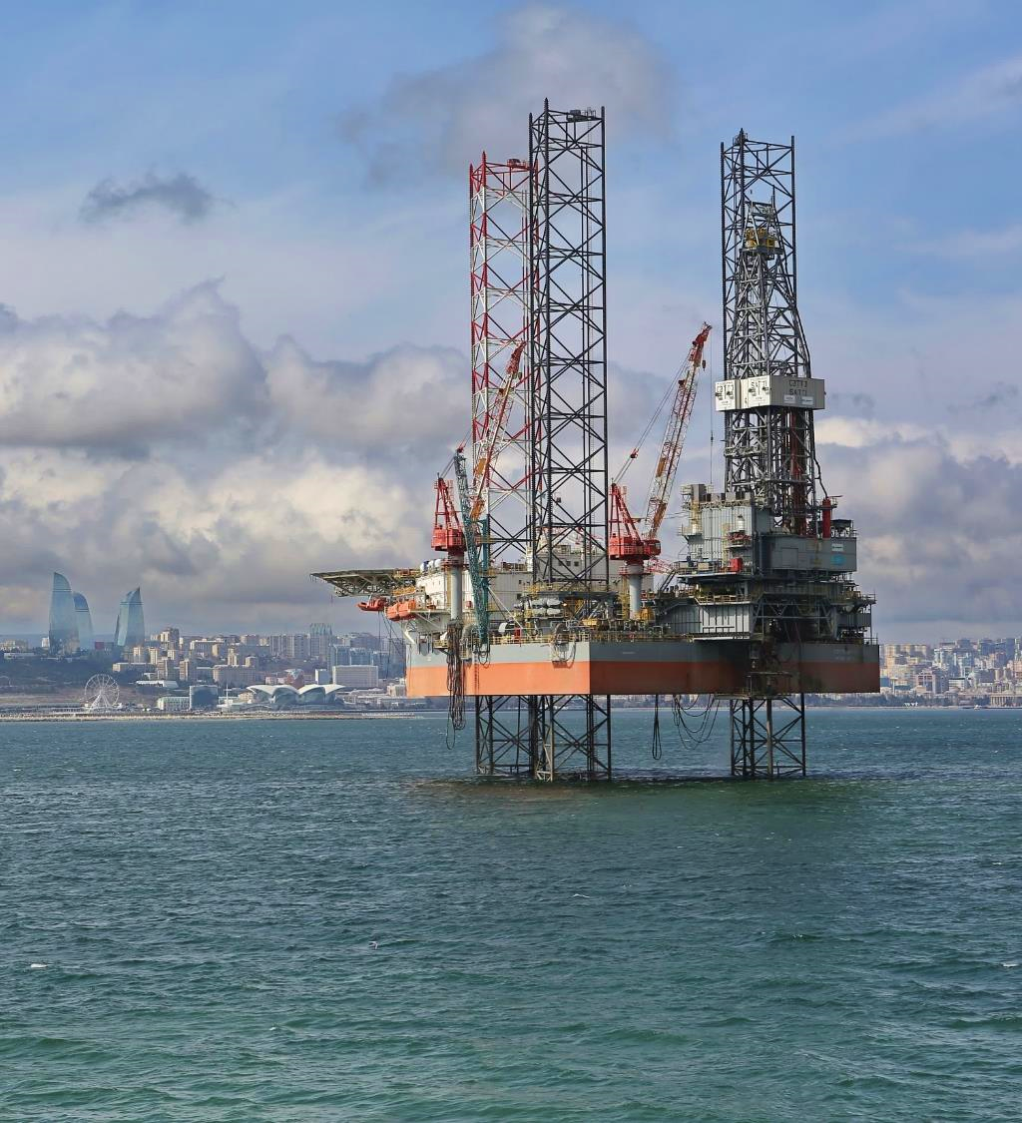
1Q 2022 highlights –exploration
On the Shafag-Asiman offshore block, the drilling of the first exploration well was completed in March 2021. Post-well analysis of the data received during the drilling is ongoing.
In the SWAP area, the third exploration was spudded on 4 April 2022. Drilling activities are currently ongoing at the depth of around 770 metres. The second well was safely plugged and abandoned in March 2022 at its total depth of 4,230 meters.
Satti jack-up rig

Slide 8
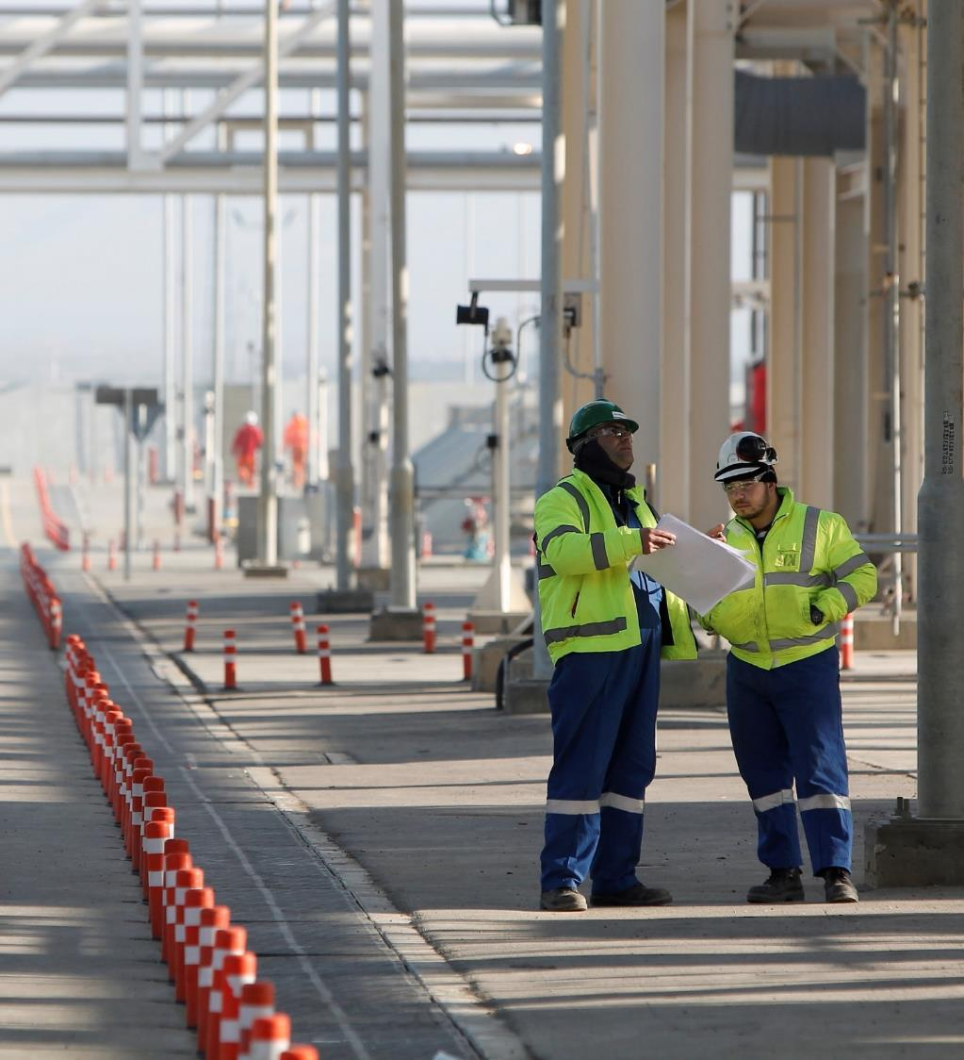
1Q 2022 – bp employees
2,247 Azerbaijani nationals directly employed by bp (including fixed-term employees)
90% of professionals in Azerbaijan comprised of national employees
Permanent professional employees in Azerbaijan
10%
Azerbaijanis
Expatriates
90%

Slide 9
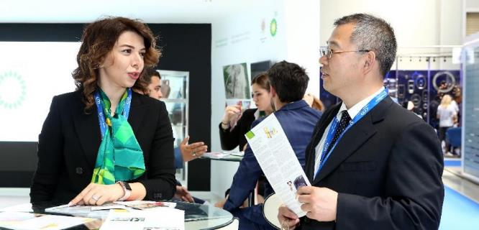
1Q 2022 - Local content
National contractors/suppliers (Azerbaijan-Georgia-Turkey region) | Number | Spend ($ million)
Small and medium enterprises State-owned companies Joint ventures with national partners In-country spend with foreign suppliers | 155 15 13 84 | 63.6 9.7 172.8 87.3 | 60% of total third-party expenditure
Total in-country spend ¹ | 267 | 333.3
This amount represents bp's direct spend with national suppliers and indirect (subcontracted) spend on national labour/services/materials in contracts with the international suppliers working in the region.

Slide 10
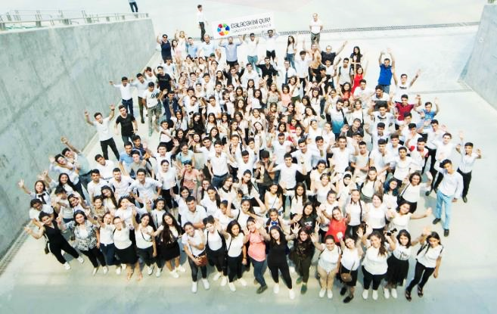
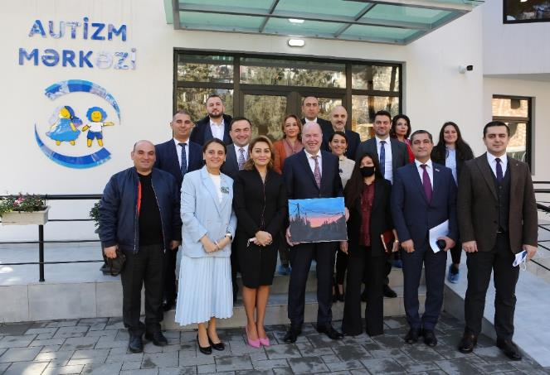
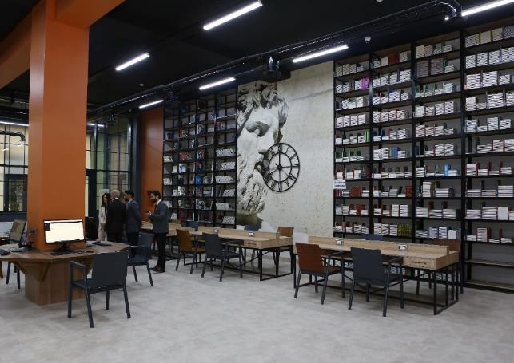
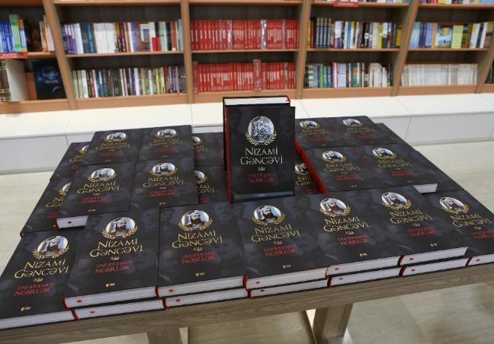
1Q 2022 - social initiatives
Social spend in Azerbaijan
($ million disbursed)
bp and its co-venturers in bp-operated projects | 1.0
bp 100% | 0.2
Total | 1.2
Creating higher education opportunities for communities
Establishing national hub of expertise
for autism specialists
Improving educational infrastructure
at local universities
Promoting Azerbaijan’s cultural heritage

